Slide 1
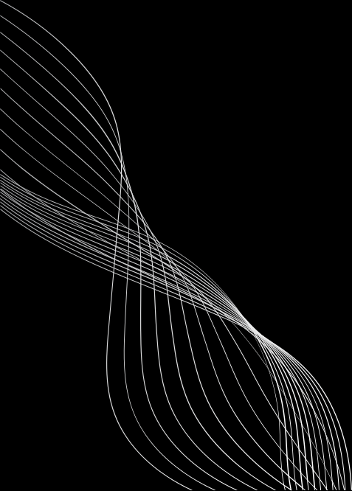


PSEUDO CLASSES, PSEUDO ELEMENTS, TRANSITIONS & MEDIA QUERIES
By The Skillians

Slide 2
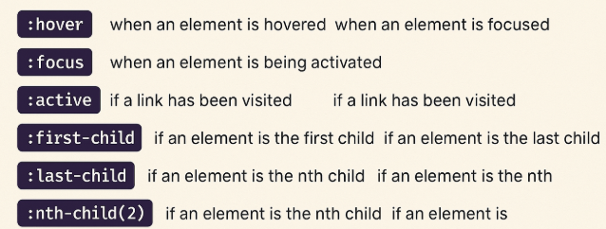
Pseudo Classes
Definition:
Pseudo-classes define the state of an element (like hover, active, focus, nth-child).

Slide 3
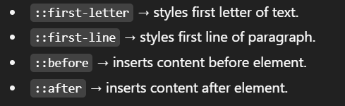
Pseudo Elements
Definition:
Pseudo-elements allow us to style specific parts of an element (like the first letter, first line, before/after content).

Slide 4
The CSS transition Property
transition: width 0.5s ease-in-out 0.3s;
transition-property (Required)
transition-duration (Required)
transition-timing-function
transition-delay

Slide 5
CSS Transition Speed Curve
.
This property can have one of the following values:
ease - transition will start slow, then go fast, and end slow (this is default)
linear - transition will keep the same speed from start to end
ease-in - transition will start slow
ease-out - transition will end slow
ease-in-out - transition will have a slow start and end
cubic-bezier(n,n,n,n) - lets you define your own values in a cubic-bezier function

Slide 6
CSS Media Queries

Slide 7
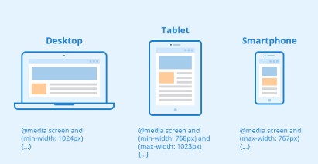
1. What is Responsive Web Design (RWD)?
Websites are viewed on different devices: mobile, tablet, laptop, large desktop.
RWD ensures your website adapts automatically without breaking.
Achieved by:
Fluid layouts (flex/grid)
Relative units (%, em, rem, vh, vw)
Media Queries

Slide 8
2. What are Media Queries?
Media Queries allow CSS to apply conditionally based on device features.
Common features used:
width (screen size)
height (not common, but useful for fixed devices)
orientation (portrait/landscape)
resolution (HD/Retina displays)
@media (condition) {
/* CSS here */
}

Slide 9
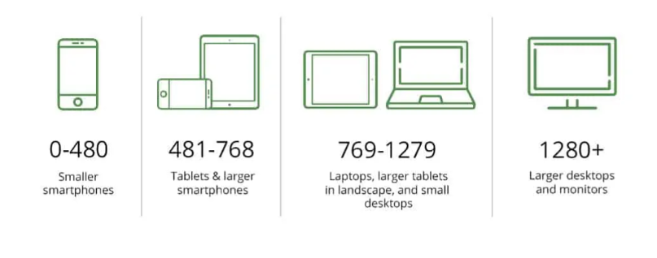
Breakpoint

Slide 10
3. min-width vs max-width vs Both
a) max-width
Means “apply styles up to this width”.
Used for desktop-first design → design for big screens first, then shrink.
Example
Apply styles when screen is 768px or smaller @media (max-width: 768px) {
body { background: pink; }
}
b) min-width
Means “apply styles from this width upwards”.
Used for mobile-first design → start small, then expand.
Example
Apply styles when screen is 768px or larger
@media (min-width: 768px) {
body { background: lightblue; }
}

Slide 11
c) Both Together (min-width + max-width)
Apply styles only in a specific range (between two breakpoints).
Example
Styles only between 600px and 900px
@media (min-width: 600px) and (max-width: 900px) {
body { background: lightgreen; }
}

Slide 12
